Slide 1
Review 2.3 Course Code – 19CCE499 Batch ID: ECE002 Deep Learning Based Solar Panel Defect Detection and Performance Evaluation Using Luminescence Images
TEAM MEMBERS:
Akiellan S - CB.EN.U4CCE22011
Ranjith Balu - CB.EN.U4CCE22037
Vishal Thangakumar - CB.EN.U4CCE22053
MENTOR:
Dr. Appu Rshikesan Paduthol
Department of Electronics and Communication Engineering

Slide 2
Motivation and Objective
Solar cell defects reduce panel efficiency and energy output.
Manual inspection is slow and not scalable.
Use deep learning to automatically detect defects from EL images.
Link detected defects with electrical performance parameters.

Slide 3
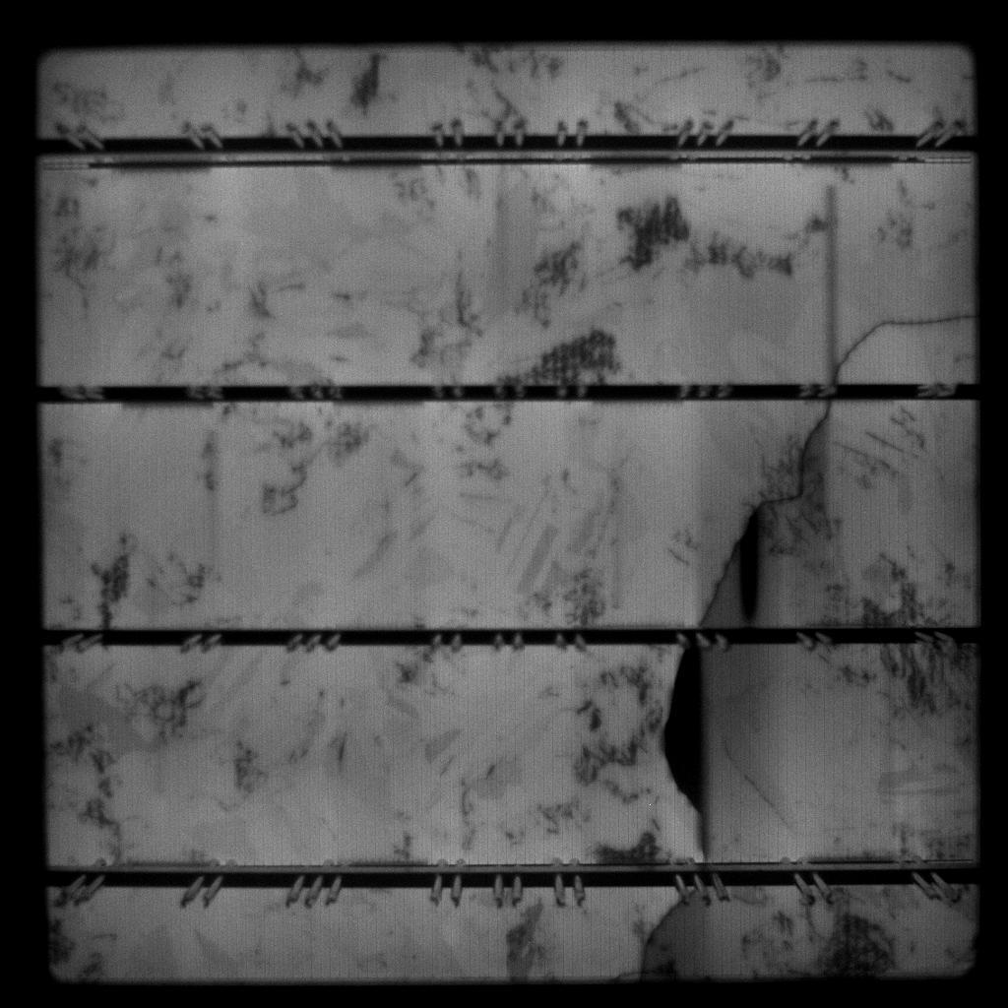
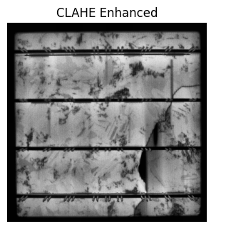
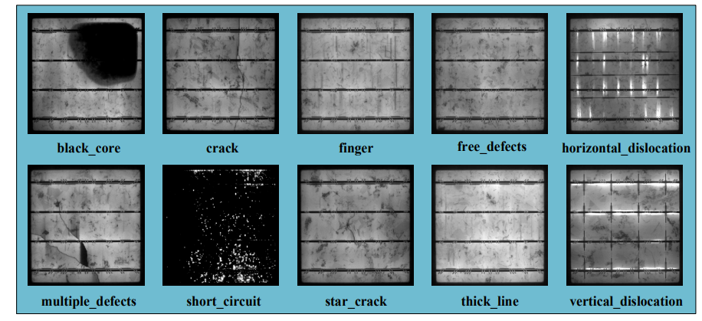
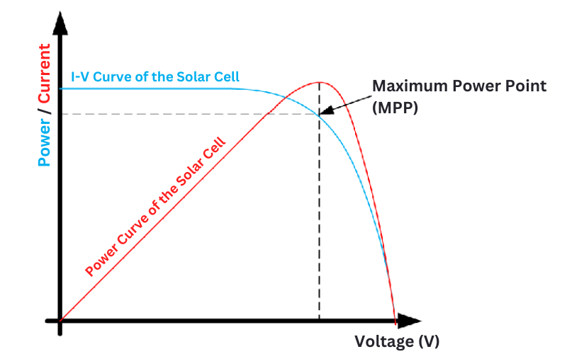
Methodology
Open source
dataset
Types of Defects
Preprocessing and Data Augmentation
Build an Object Detection Model
Model Performance Analysis
Industry
Dataset
Electrical Parameters
Preprocessing
Feature Correlation Analysis
Build
Regression Model
Final Results
IV Curve

Slide 4
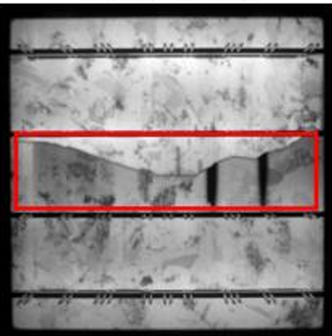
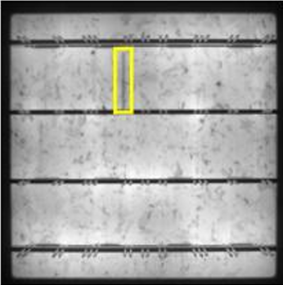
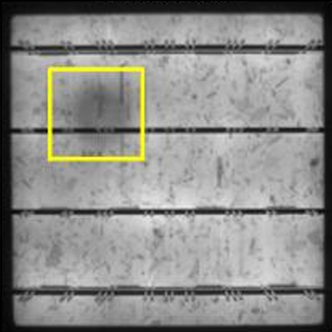
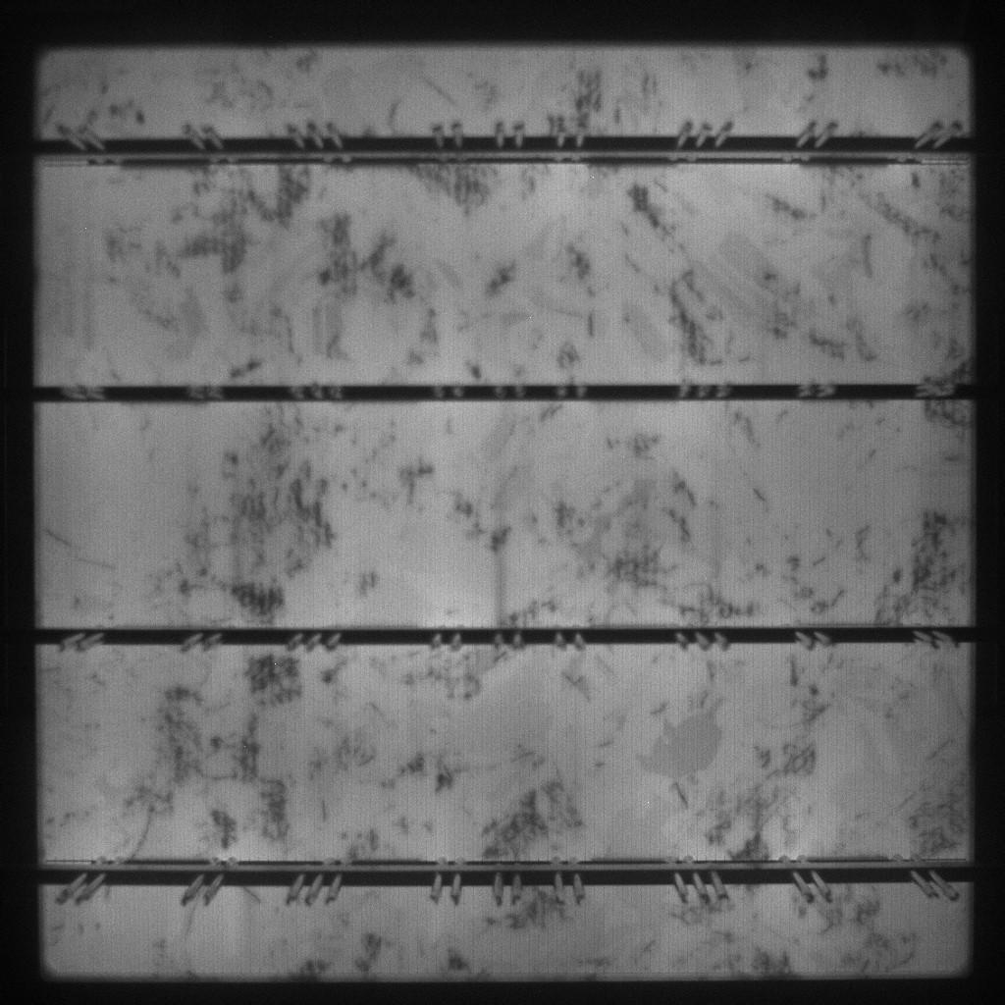
Open Source Dataset Details - PVELAD
Crack
Finger
Thick Line
Good

Slide 5
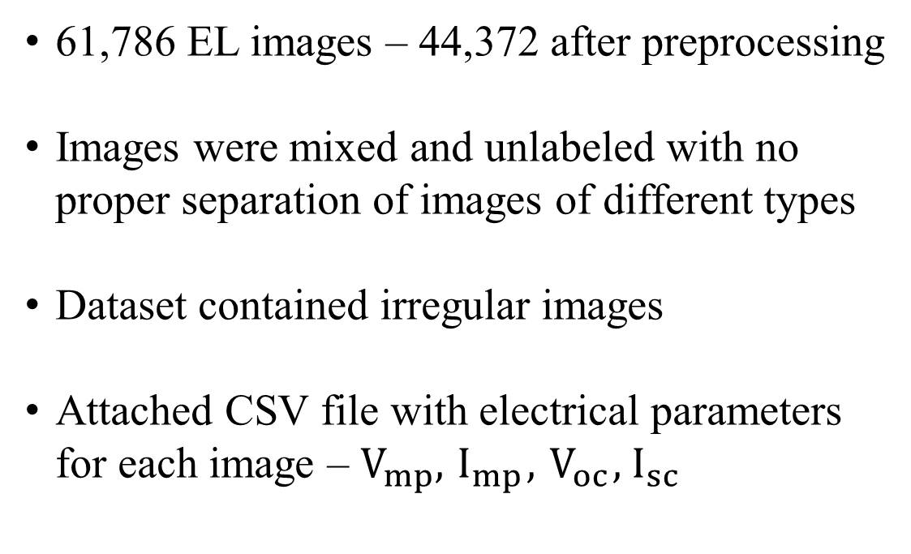
Industry Dataset Details
61,786 EL images – 44,372 after preprocessing
Images were mixed and unlabeled with no proper separation of images of different types
Dataset contained irregular images
Attached CSV file with electrical parameters for each image – $V_{mp}, { I}_{mp},{ V}_{oc},{ I}_{sc}$

Slide 6
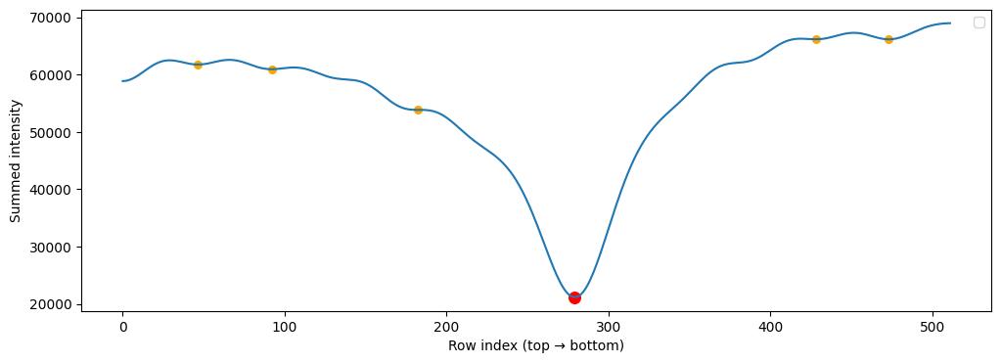
Cleaning the Dataset
Removed all images with 2 solar cells
Images with
2 solar cells

Slide 7
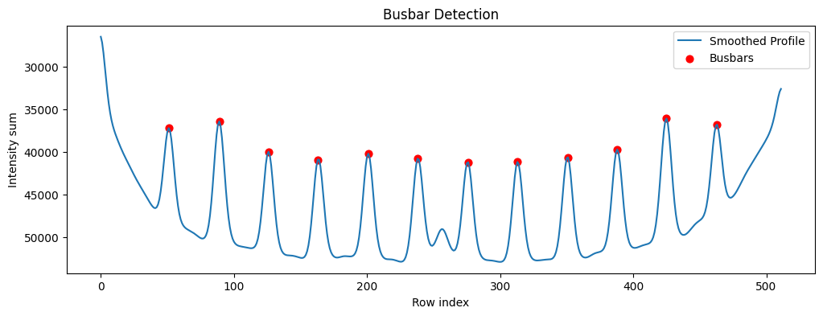
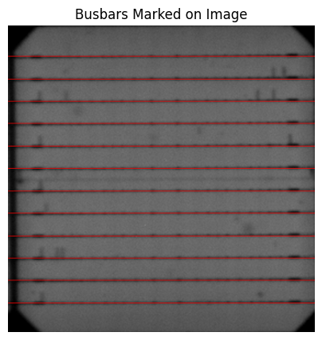
Cleaning the Dataset
Retained images with 3, 4 and 5 busbars; busbars with higher configurations were deleted

Slide 8
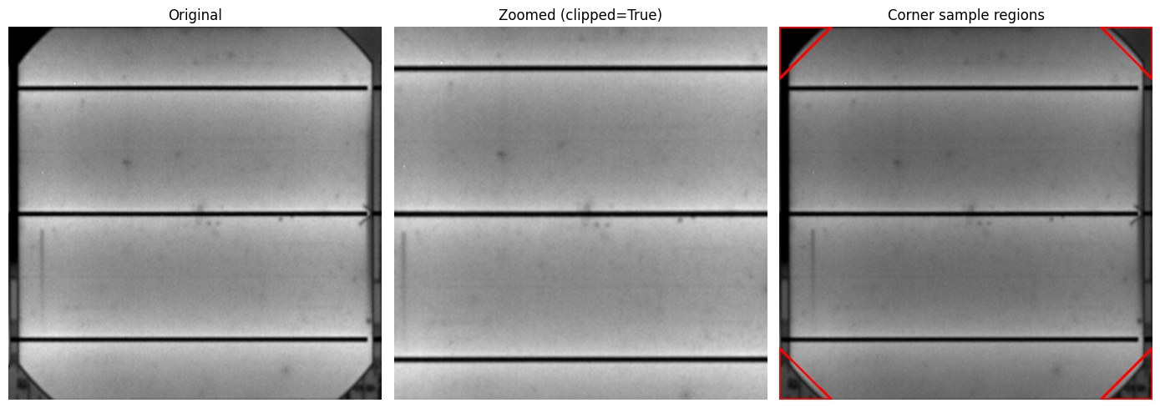
Cleaning the Dataset
Corrected clipped-corner images using zoom

Slide 9
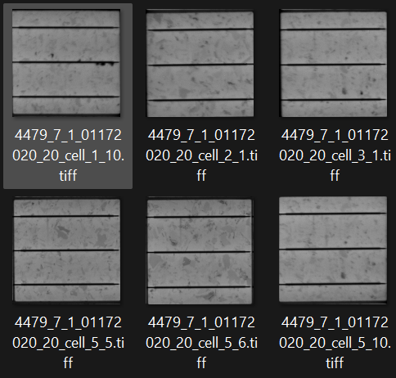
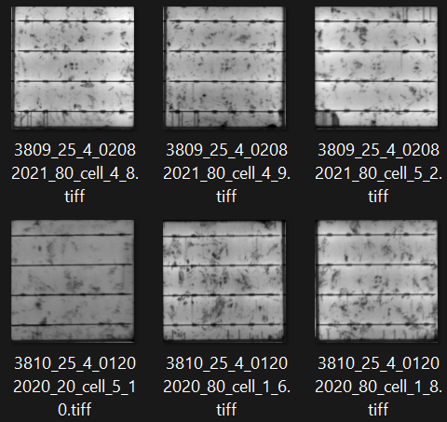
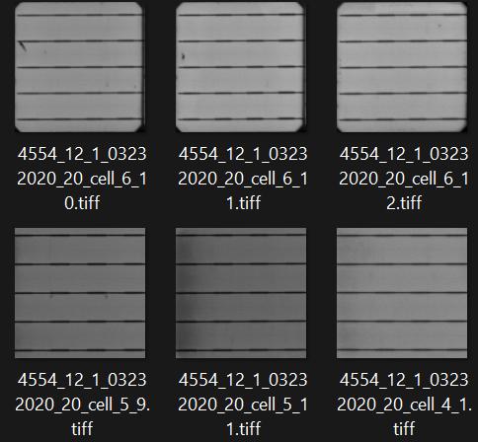
Cleaned Image Samples
3 busbars
4 busbars
5 busbars

Slide 10
Preprocessing Steps Carried Out
Resizing to 256x256
NLM denoising
CLAHE contrast enhancement
Unsharp Masking for Edge Sharpening
Morphological Closing

Slide 11
Preprocessing Steps Carried Out
Data Augmentation techniques performed:
Horizontal and Vertical Flipping
Random brightness and contrast adjustment
Rotation, Translation, Shear
Zoom augmentation during training

Slide 12
Model – Classification
Stage 1 – Classification using ResNet50 model
Classifies EL images as Good or Defective
Trained on the preprocessed open-source dataset
Filters defect-free panels before localisation

Slide 13
Model – Localisation
Stage 2 – Localisation using YOLO model
Detects defect regions using bounding boxes
Trained on the open-source dataset
Highlights specific defect regions like cracks, thick line and finger defects.

Slide 14
Model – Performance Estimation
Stage 3 – Performance Estimation using EfficientNetB0 model
Extracts features from EL images
Two branches: Image Input + Tabular Input; Tabular input consists of 19 features: 16 image-derived features + 3 defect counts
Trained on the industry dataset and predicts electrical parameters

Slide 15
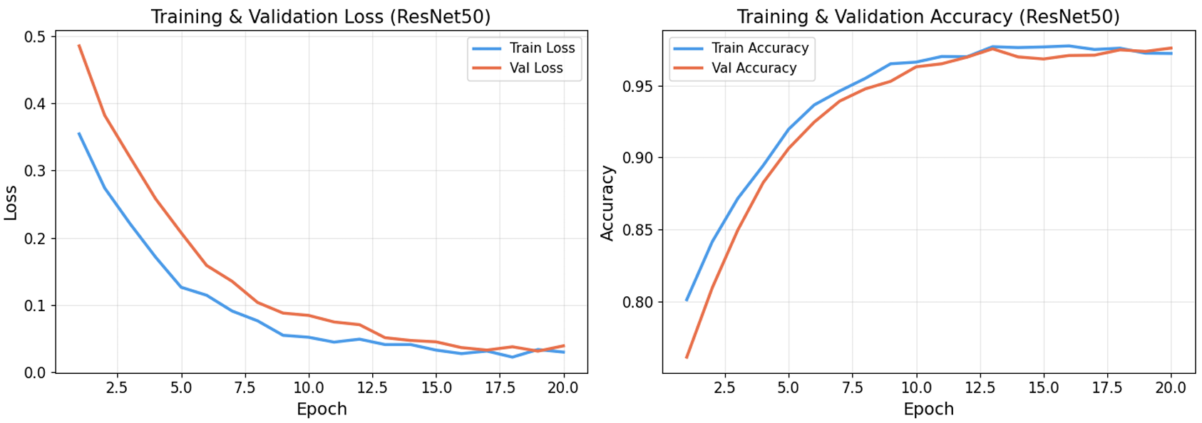
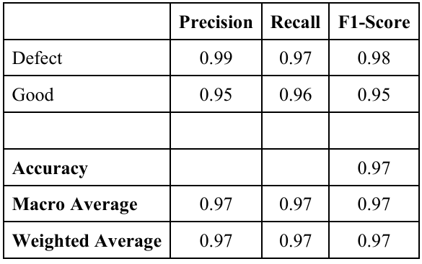
Results – Classification using ResNet50
Accuracy: 97.30%

Slide 16
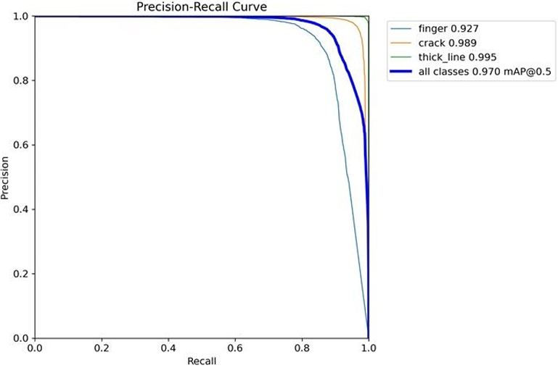
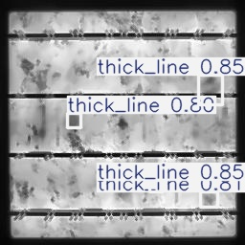
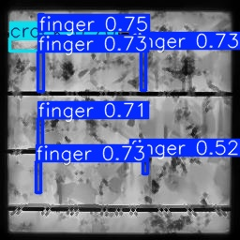
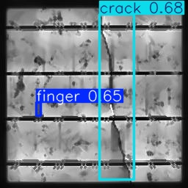
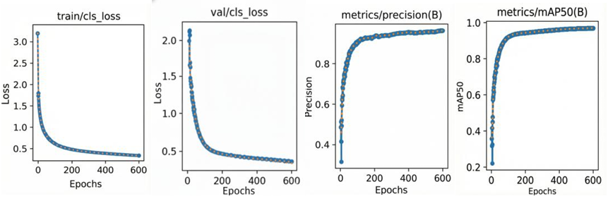
Results – Localisation using YOLOv8

Slide 17
Correlation Analysis
Objective:
To understand how solar cell defects affect electrical performance (Voc, Isc, ΔVoc ).
To check whether image features (brightness, dark areas, defect size) are related to voltage loss.
To identify defect characteristics that cause voltage degradation
To evaluate whether EL images can predict solar panel efficiency

Slide 18
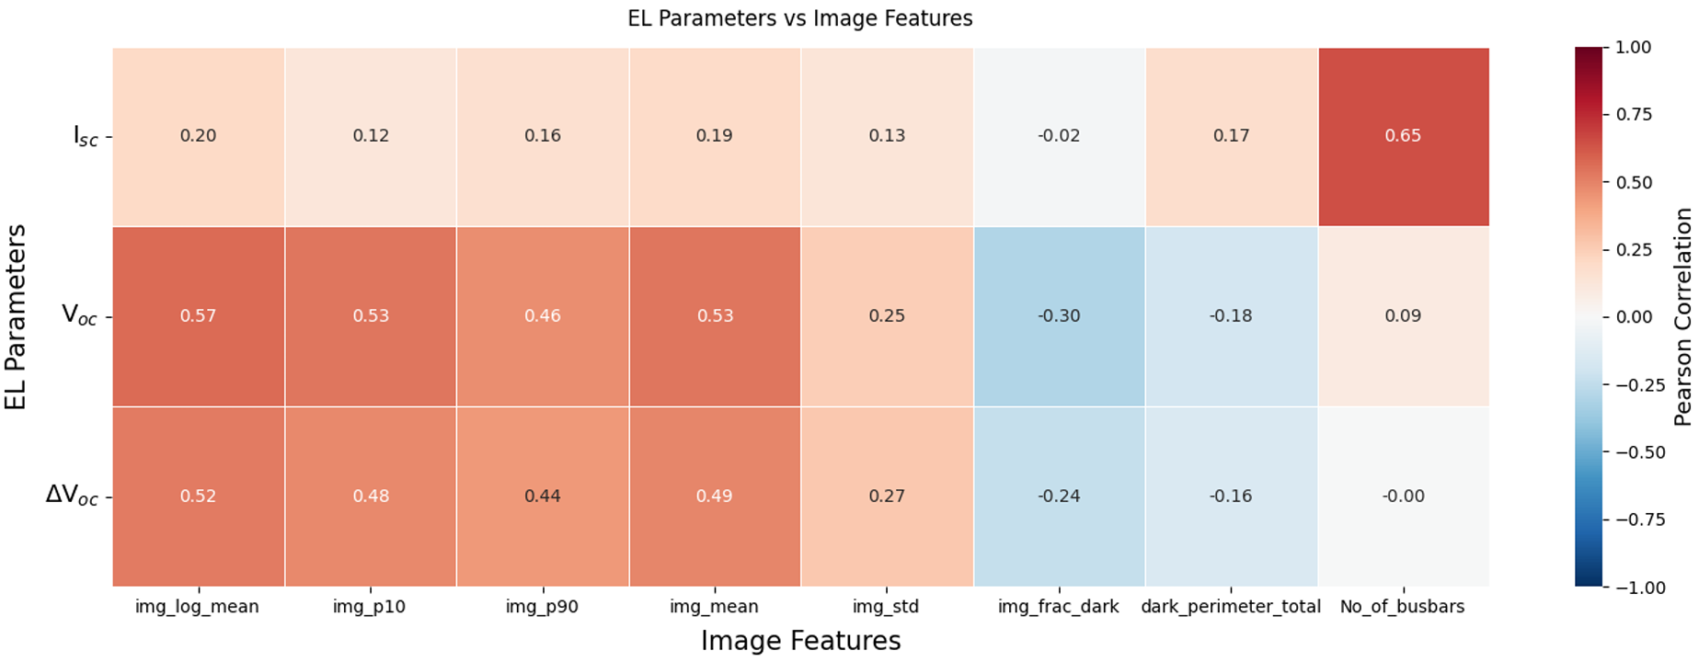
Correlation Analysis
Mean EL intensity strongly correlates with Voc
ΔVoc shows similar correlation trend with brightness features
Isc shows weaker but noticeable association with busbar configuration
Voltage degradation is more strongly associated with global EL brightness than with simple defect counts

Slide 19
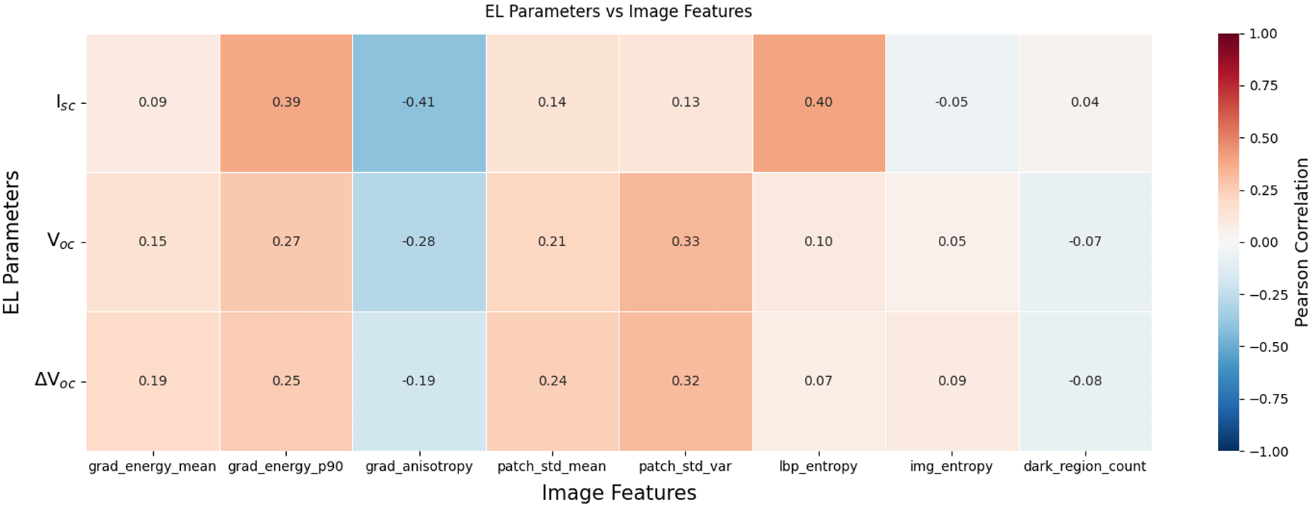
Correlation Analysis
Gradient and patch variance features show moderate correlation with Voc and ΔVoc
grad_anisotropy negatively correlates, indicating directional crack impact
Texture irregularities moderately associated with voltage degradation

Slide 20
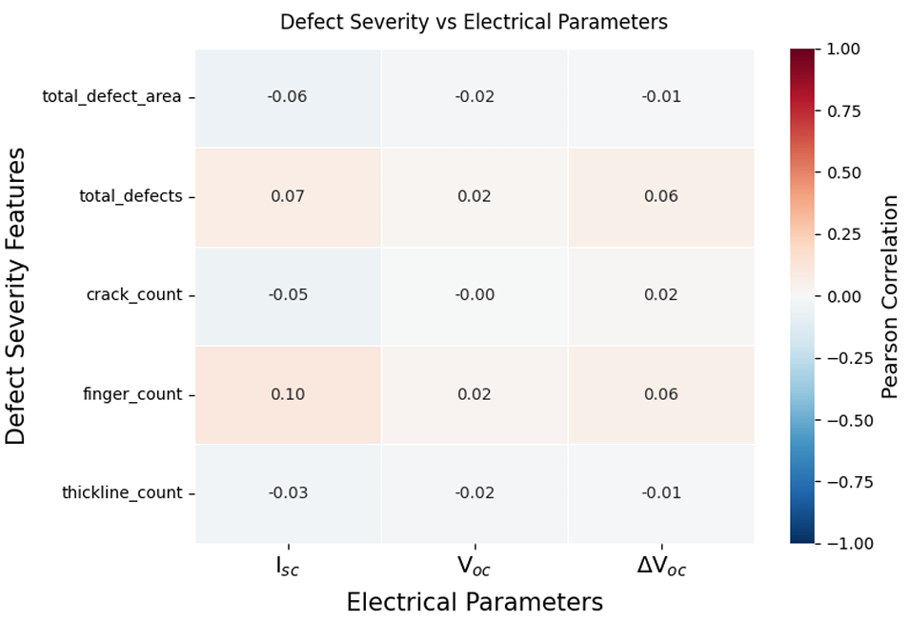
Correlation Analysis
Individual defect counts show very weak direct correlation with Voc and ΔVoc
Total defect area exhibits minimal linear association with electrical parameters
Suggests degradation impact is not purely proportional to defect count
Highlights the need for texture/intensity-based modelling rather than count-based modelling

Slide 21
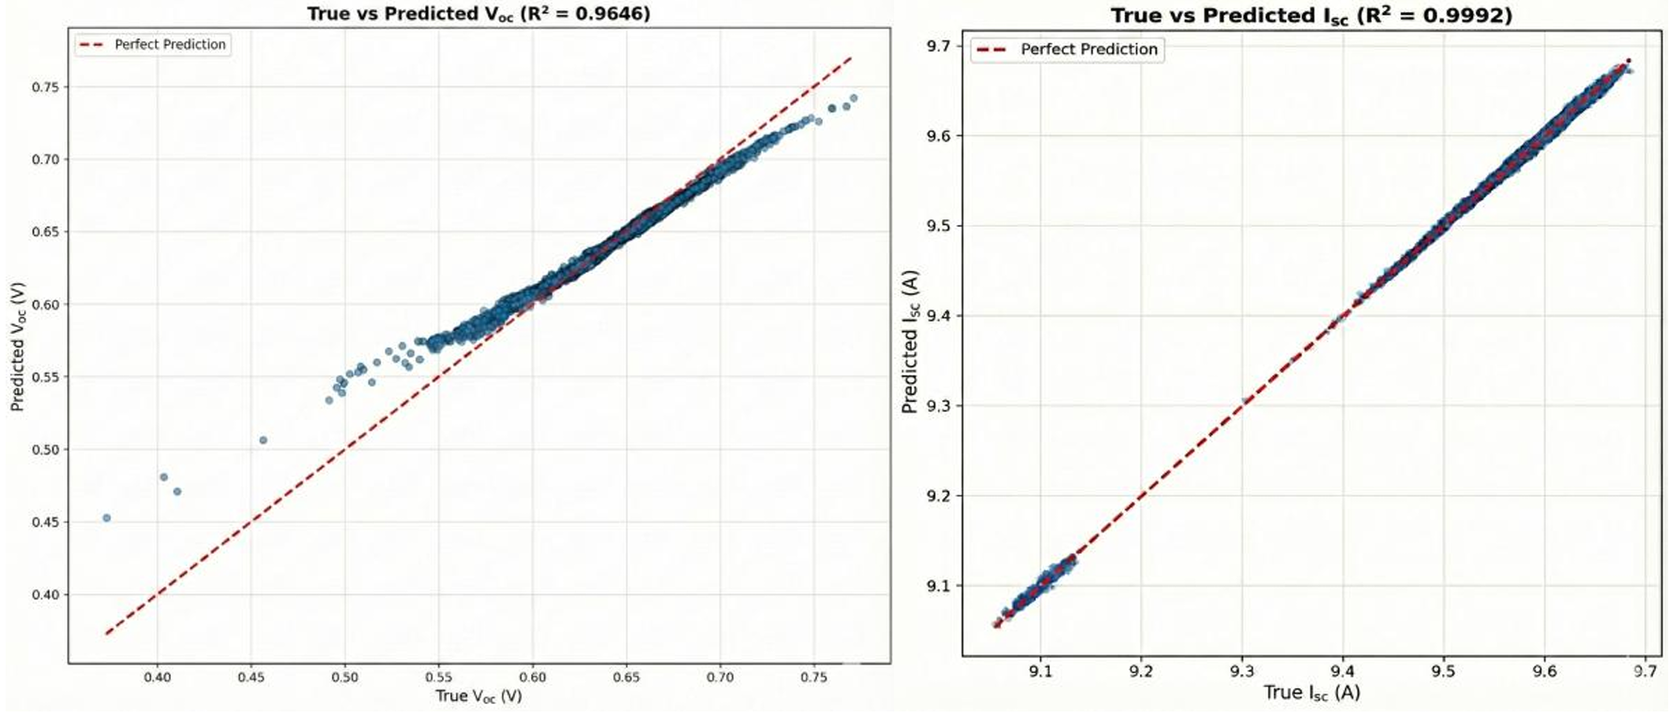
Results – Performance Estimation
Initial Regression Results

Slide 22
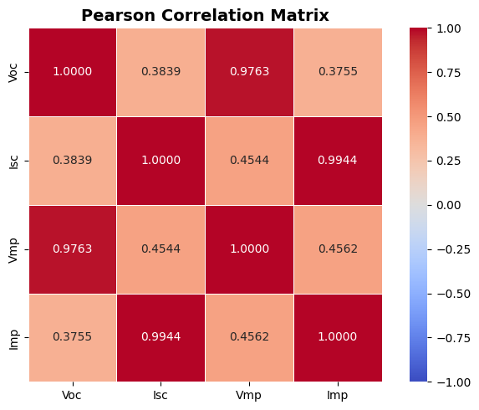
Possible Reasons for Near Perfect Metrics
Strong linear correlation observed between electrical parameters
Model might’ve learnt electrical relationships instead of defect features from image
Narrow distributions for Voc and Isc
Random train-test split might’ve have caused similar data distributions in both sets

Slide 23
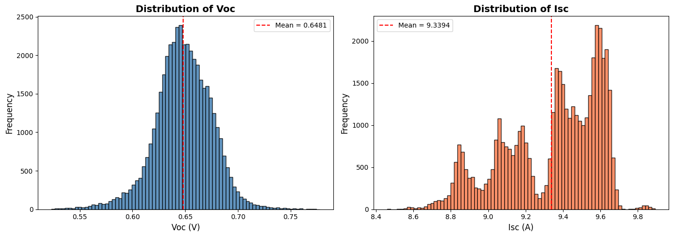
Histogram distribution of Voc and Isc

Slide 24
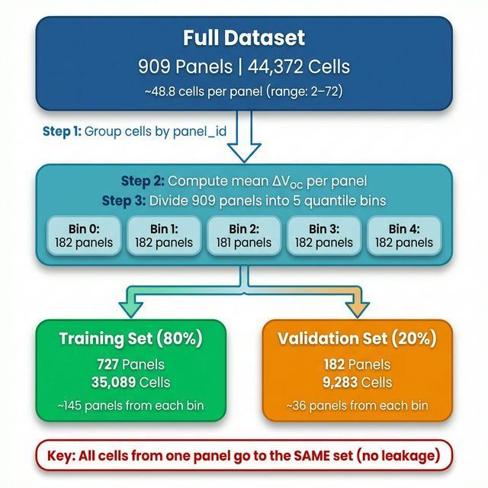
Rectification Strategy
Removed direct electrical parameter fusion for regression
Evaluated image-only regression to ensure learning from defect features
Predict ΔVoc along with Voc and Isc
Implemented stricter train–test separation to reduce distribution overlap

Slide 25
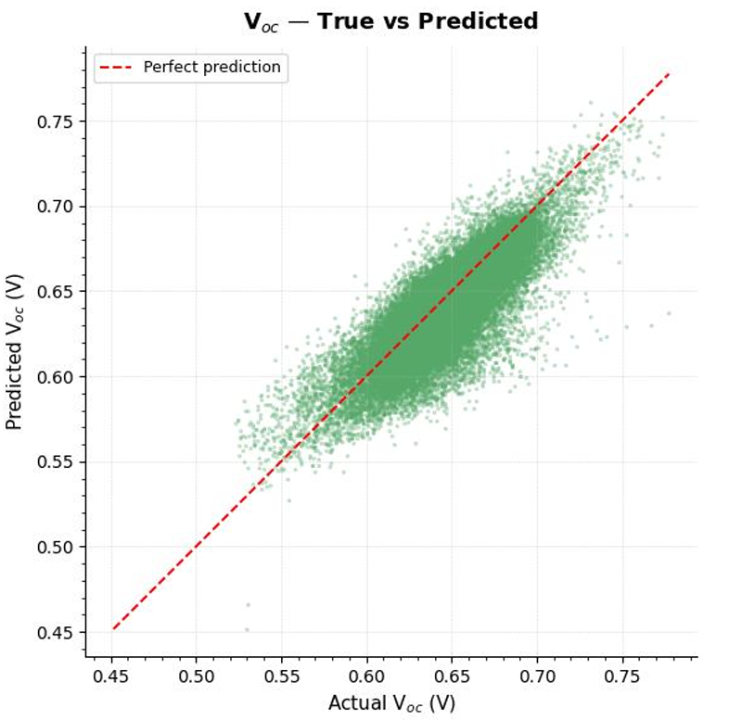
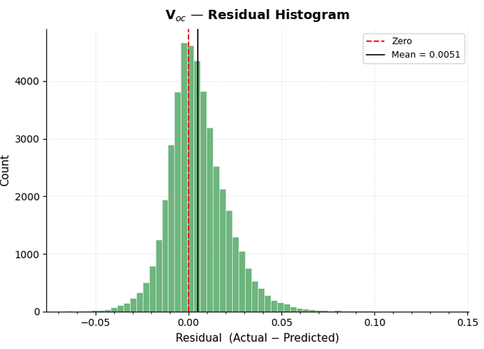
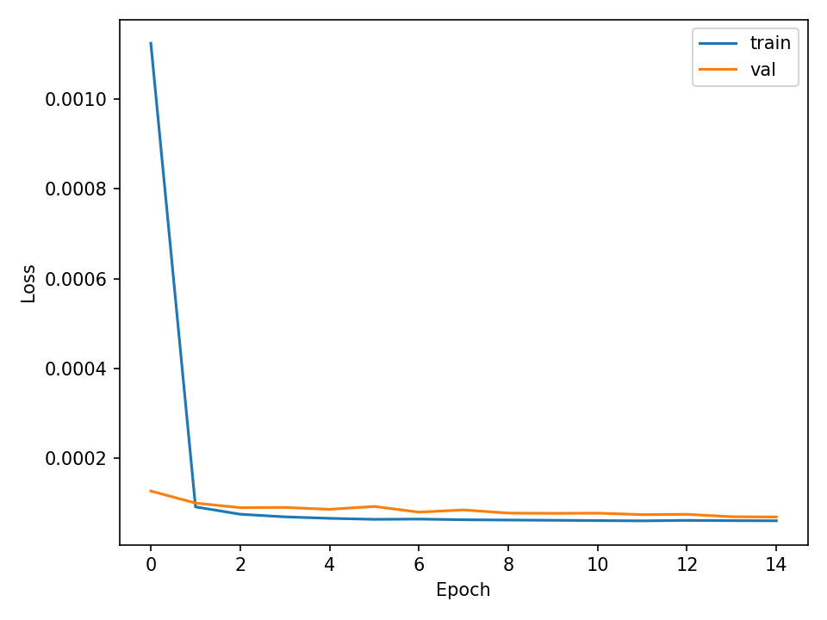
Results – Voc Regression
The predicted Voc values exhibit strong linear concordance with ground truth, closely aligning with the y = x reference line and indicating low bias across the dynamic range
MAE: 0.0123 V
RMSE: 0.0167 V
R²: 0.6158
Pearson r: 0.8224

Slide 26
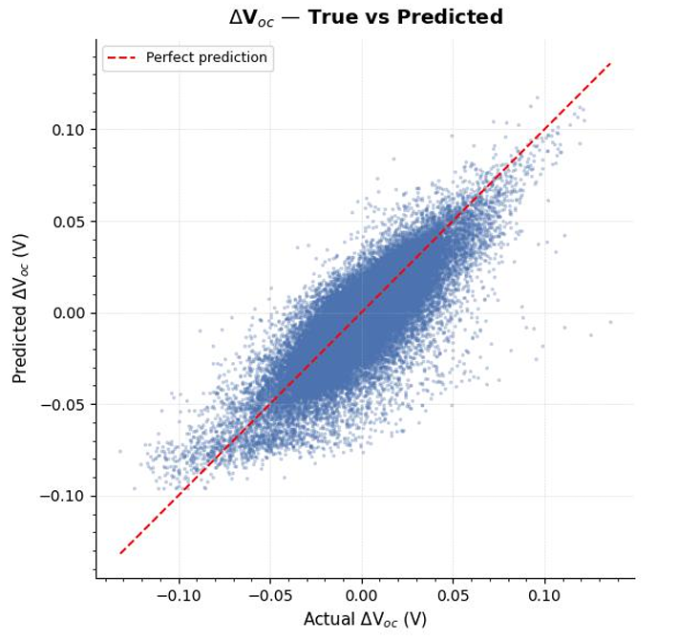
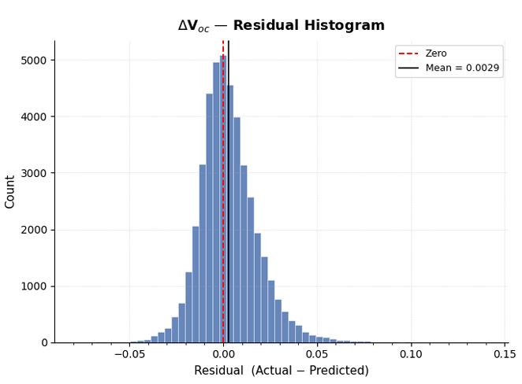
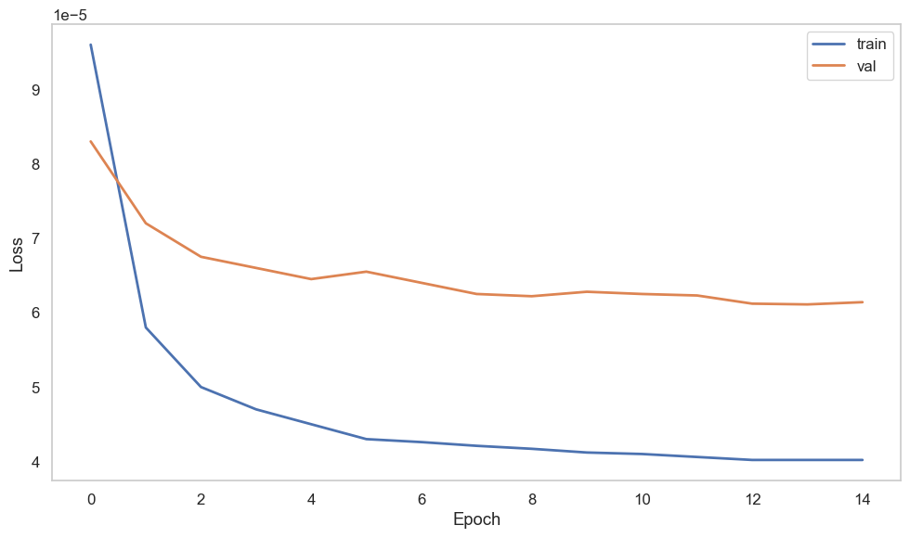
Results – ΔVoc Regression
Strong linear correlation shows predictions closely follow the ideal diagonal line, indicating good regression performance
MAE : 0.0116 V
RMSE : 0.0158 V
R² : 0.6340
Pearson r : 0.8211

Slide 27
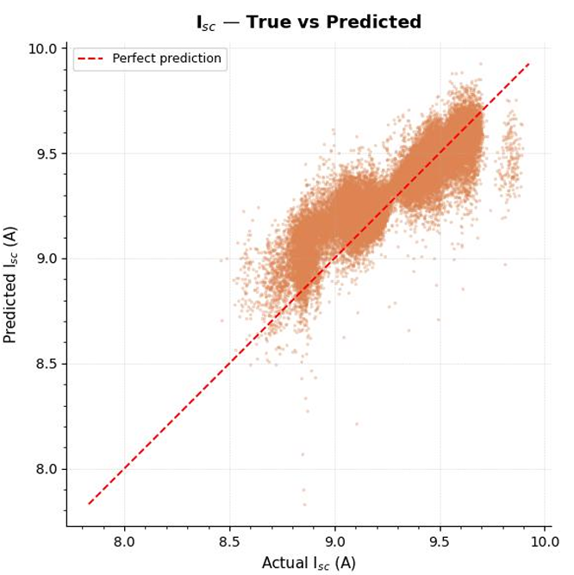
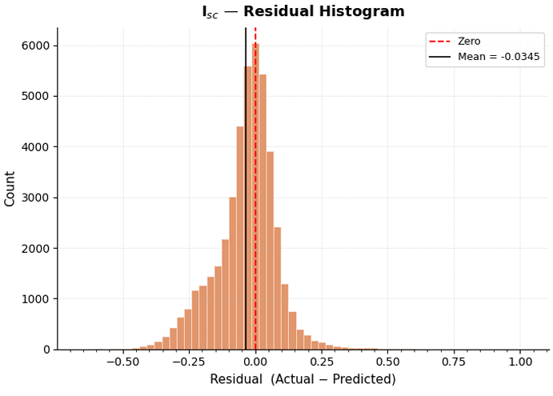
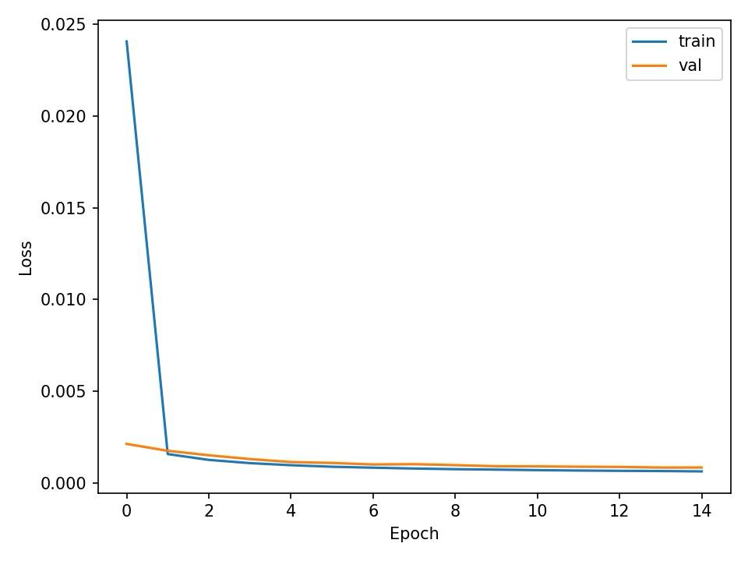
Results – Isc Regression
Isc prediction is more sensitive to illumination and surface defects. Crack density and dark pixel regions show stronger association with Isc loss.
MAE : 0.0861 A
RMSE : 0.1202 A
R² : 0.7844
Pearson r : 0.9047

Slide 28
Result Comparison with Literature
Comparison of Defect Classification Models
Reference | Model | Dataset Size | No: of Classes | Accuracy (%) | Remarks
M. W. Akram et al.[1] | Light CNN | 2,624 Images | 2 | 93.02 | CNN-based Classifier
W. Tang et al.[2] | CNN + GAN | 32,600 Images | 4 | 83.00 | GAN-based Augmentation
M. Abdelsattar et al.[3] | MobileNetV2 | 3,102 Images | 2 | 99.95 | Compared 24 CNN Architectures
Proposed Solution | ResNet50 | 9,860 Images (PVEL-AD) | 2 | 92.85 | Transfer Learning + Preprocessing

Slide 29
Result Comparison with Literature
Comparison of Defect Localisation Models
Reference | Model | Dataset | No: of Classes | mAP@50 (%) | Remarks
A. Binomairah et al.[4] | YOLO + SPP | PL images (PERC cells) | 2 | 97.4 | Microcrack & dark spot detection
L. R. Yeddula et al.[5] | YOLOv8n-GBE | PVEL-AD | 12 | 96.5 | Hybrid YOLOv8 with Ghost + BiFPN + ECA
A. Mohamed et al.[6] | PV-YOLOv12n | PVEL-AD | 8 | 91.3 | Lightweight optimized YOLO
Proposed Solution | YOLOv8 | PVEL-AD | 3 | 97.00 | Transfer Learning + Preprocessing

Slide 30
Result Comparison with Literature
Comparison of Regression Models
Reference | Model | Dataset | Input Type | Target Parameters | R² | Pearson-r | MAE | RMSE | Remarks
Ozturk et al.[7] | CNN-based DL Pipeline | 29 PV modules (EL + IV measured) | EL Images | Power Output (Pmpp) | - | - | 0.03547 | 0.04892 | EL-based joint fault detection + parameter estimation
S. Abdelghafar et al.[8] | BO-Bagging Ensemble | Organic PV material dataset | Molecular descriptors (non-image) | Voc, Jsc, FF, PCE | 0.73 (Voc) 0.84(Jsc) | 0.854 (Voc) 0.917 (Jsc) | 0.0282 (Voc) 1.1954 (Jsc) | 0.0415 (Voc) 1.5988 (Jsc) | Material-level regression; not EL image-based PV defect analysis
Proposed Solution | EfficientNetB0 | Industrial EL + IV dataset | EL Images | Voc, ΔVoc, Isc | 0.61 (Voc) 0.63 (ΔVoc) 0.78 (Isc) | 0.82 (Voc) 0.82 (ΔVoc) 0.90 (Isc) | 0.01 (Voc) 0.01 (ΔVoc) 0.08 (Isc) | 0.01 (Voc) 0.01 (ΔVoc) 0.12 (Isc) | EL images based regression

Slide 31
References
[1] M. W. Akram, G. Li, Y. Jin, X. Chen, C. Zhu, X. Zhao, A. Khaliq, M. Faheem, and M. Ahmad, "CNN based automatic detection of photovoltaic cell defects in electroluminescence images," Energy, vol. 189, Dec. 2019, Art. no. 116319, doi: 10.1016/j.energy.2019.116319.
[2] W. Tang, Q. Yang, K. Xiong, and W. Yan, “Deep learning based automatic defect identification of photovoltaic module using electroluminescence images,” Sol. Energy, vol. 201, pp. 453–460, Mar. 2020, doi: 10.1016/j.solener.2020.03.049.
[3] M. Abdelsattar, A. Abdelmoety, M. A. Ismeil and A. Emad-Eldeen, "Automated Defect Detection in Solar Cell Images Using Deep Learning Algorithms," IEEE Access, vol. 13, pp. 4136-4157, Jan. 2025.
[4] A. Binomairah, A. Abdullah, B. E. Khoo, Z. Mahdavipour, T. W. Teo, N. S. M. Noor, and M. Z. Abdullah, "Detection of microcracks and dark spots in monocrystalline PERC cells using photoluminescence imaging and YOLO-based CNN with spatial pyramid pooling," EPJ Photovoltaics, vol. 13, pp. 27, Dec. 2022, doi: 10.1051/epjpv/2022025.
[5] L. R. Yeddula, A. Pallakonda, R. D. A. Raj, R. M. R. Yanamala, K. K. Prakasha, and M. S. Kumar, “YOLOv8n-GBE: A Hybrid YOLOv8n Model With Ghost Convolutions and BiFPN-ECA Attention for Solar PV Defect Localization,” IEEE Access, vol. 13, pp. 114012-114028, Jun. 2025, doi: 10.1109/ACCESS.2025.3584249

Slide 32
References
[6] A. Mohamed, Y. Nacera, B. Ahcene, A. Teta, E. O. Belabbaci, A. Rabehi, Y. A. Alsabah, and M. Benghanem, “Optimized yolo based model for photovoltaic defect detection in electroluminescence images,” Scientific Reports, vol. 15, no. 1, pp. 32955, Sept. 2025, doi: 10.1038/s41598-025-13956-7
[7] E. Ozturk, E. Ogliari, M. Sakwa, A. Dolara, N. Blasuttigh and A. M. Pavan, “Photovoltaic modules fault detection, power output, and parameter estimation: A deep learning approach based on electroluminescence images,” Energy Convers. Manag., vol. 319, Art. no. 118866, Nov. 2024, doi: 10.1016/j.enconman.2024.118866.
[8] S. Abdelghafar, H. Alshater, L. M. Abouelmagd, A. Darwish and A. E. Hassanien, “Organic photovoltaic prediction model based on Bayesian optimization and explainable”, AI. Sci. Rep., vol. 15, pp. 32559, Sept. 2025, doi: 10.1038/s41598-025-18632-4

